Slide 1
Survival of Titanic Passengers
By: Almog Amiga and Ariel Yechezkel

Slide 2
Understanding the features
Age is in years
survived (0=no, 1=yes).
Sex refers to gender (male/female).
SibSp is the number of siblings aboard.
Parch is the number of parents aboard.
Pclass refers to passenger class (1st, 2nd, 3rd).
Embarked refers to Port of Embarkation ,Ticket refers to the ticket number, Fare refers to passenger fare, Cabin refers to the passenger‘s cabin.

Slide 3
Cleaning the data
dropped columns that cannot help us predict if the person survived or not like: ‘Fare’, ‘Cabin’ and ‘Ticket’, which depends on ‘Pclass’ column
dropped ‘PassengerId’, ‘Name’ and ‘Embarked’ which were not helpful for our model.
splitted the ‘Pclass’ column into three different columns and we named them ‘Pclass_1’, ‘Pclass_2’, ‘Pclass_3’.
changed the 'sex' column into 0, 1 (0=female, 1=male)
normalized the ‘age’ column.

Slide 4
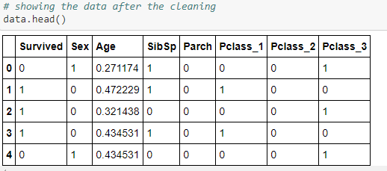

Slide 5
Simple logistic regression
We did 100000 iterations and 0.001 learning rate. We can see that after 30,000 iterations the accuracy doesn’t change, so it will be best to stop after 30,000 iterations.
The model had an accuracy of 80% on the testing set after GradientDescentOptimizer and training the data.

Slide 6
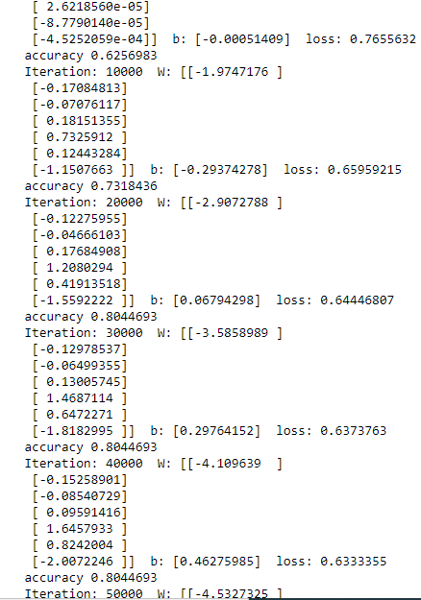

Slide 7
With hidden layer
We added one hidden layer with 3 nodes and 1,000,000 iterations and 0.001 learning rate.
More iteration because the model is more complicated
The model had an accuracy of 82% on the testing set after GradientDescentOptimizer and training the data.

Slide 8
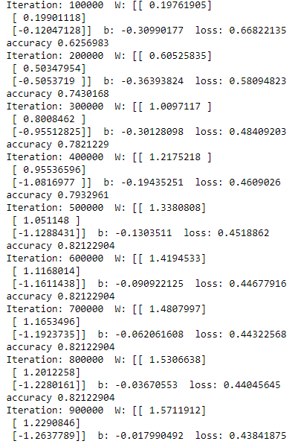

Slide 9
lstm
set our Dense layer to 5.
We used the activation layer “relu”.
5 epochs
“adam” optimizer.
LSTM is the most complicated between our models, so it should bring us to the highest accuracy.
surprisingly, after different attempts, the model had an accuracy of 79%.

Slide 10
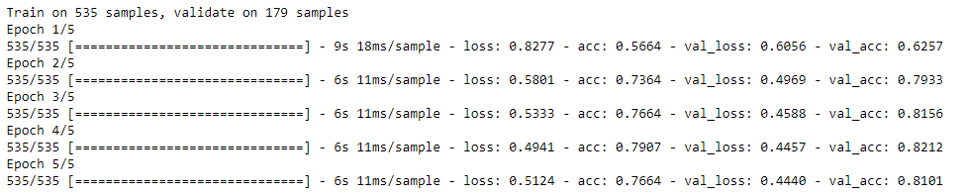

Slide 11
Attempts to improve the accuracy
Dropout.
Different optimizers (like GDE).
Dense layers.
LSTM layer with Different internal units.
We tried to find bugs in our code.

Slide 12
conclusions
The dataset is very small and after we cleaned the data it became much smaller. So it is hard to predict in high accuracy who died and who didn’t base on the data.
We found the numbers that will cause the highest accuracy that we can get without cause overfitting.
For next project we will use a larger dataset.

